Slide 1

NYC 2-Bedroom Investment Optimization
Speaker: Zhishen Lin

Slide 2
1:Reasons to select NYC

Slide 3
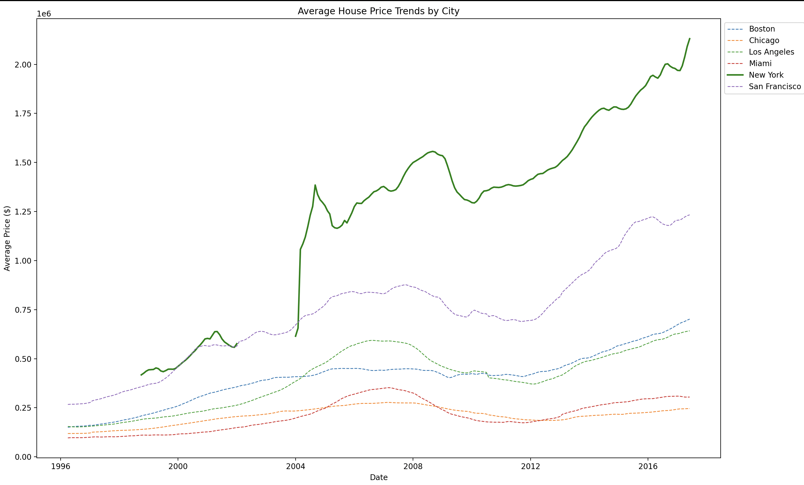
Property Price In top 6 cities

Slide 4
2:General analysis in different regions

Slide 5
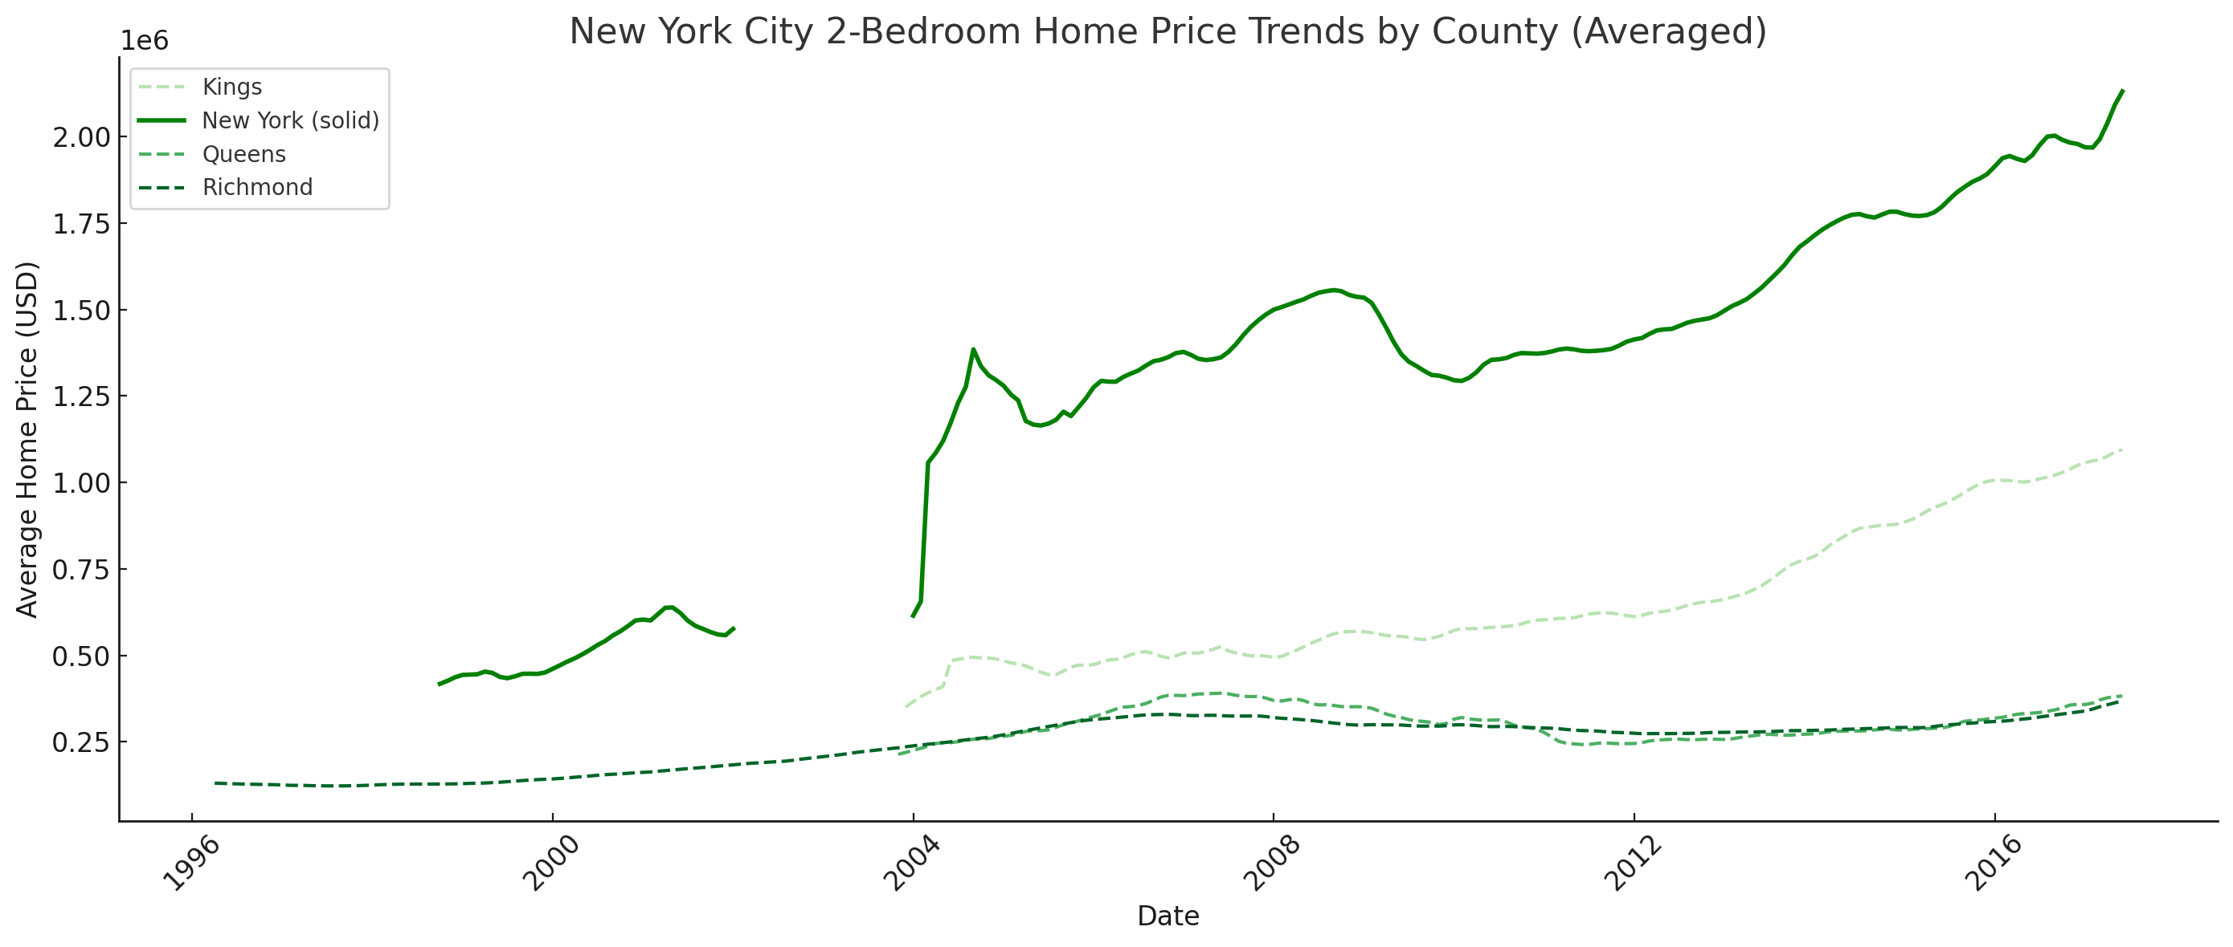

Slide 6
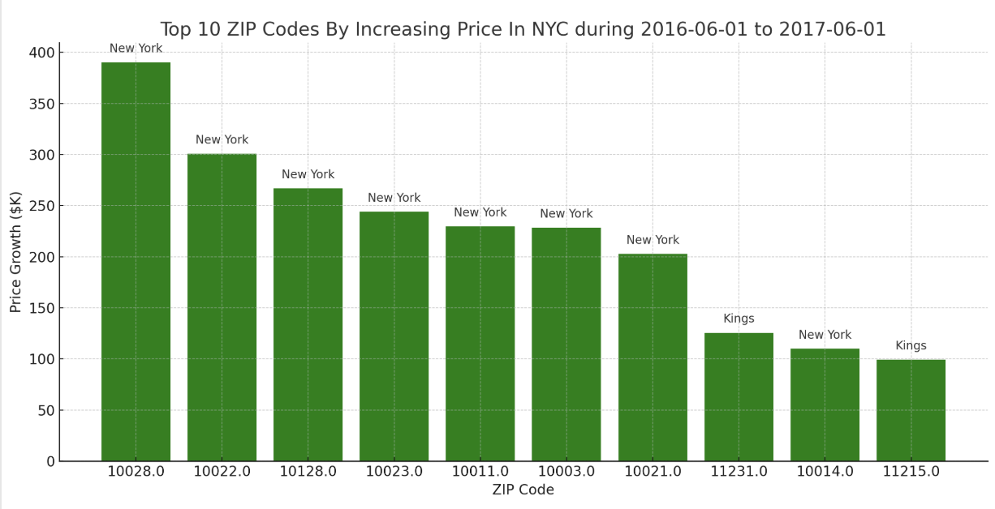

Slide 7
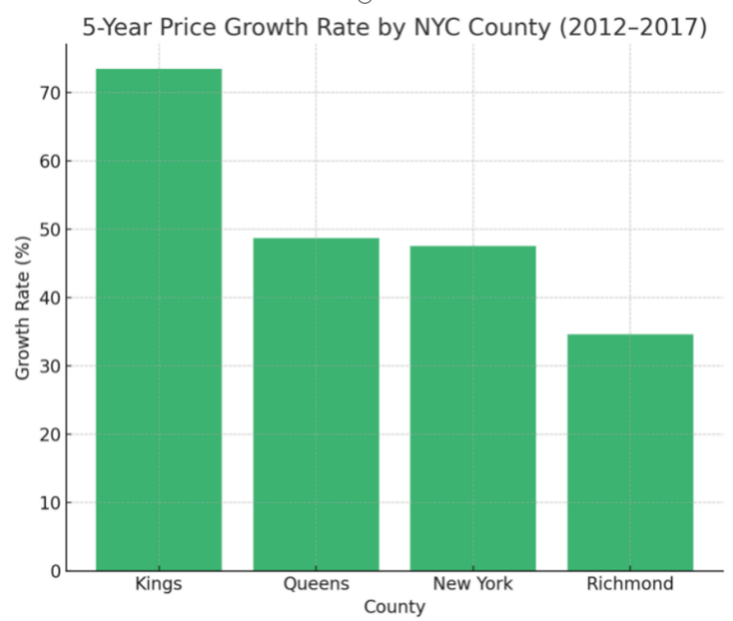
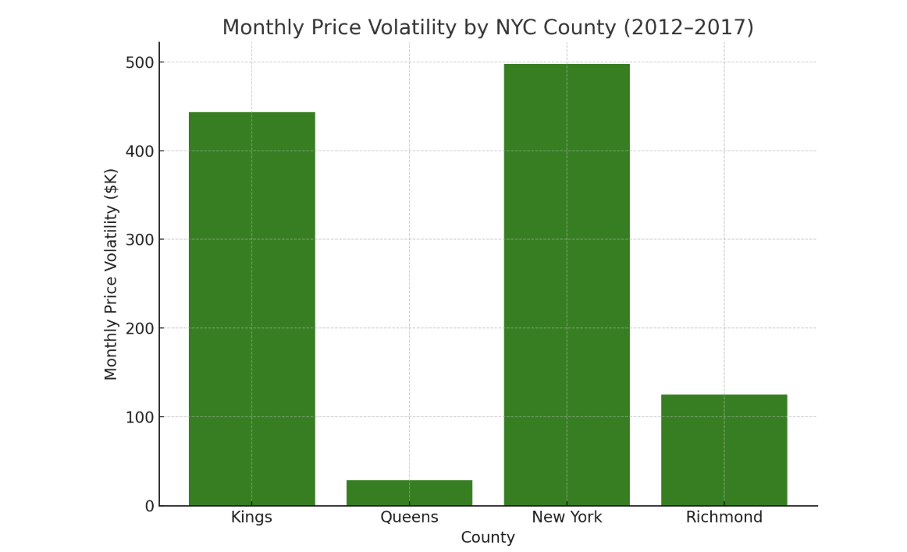

Slide 8
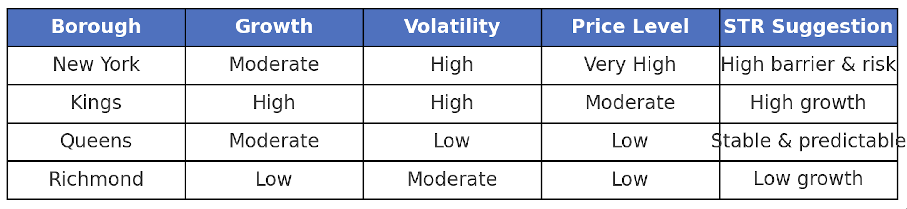

Slide 9
3:Payback analysis in different zipcodes

Slide 10
Payback calculation
Step 1: get the final revenue(one year)
final revenue =Basical rental fee+Extra Guests+Cleaning Fee+Security Deposit
Step 2: payback = final revenue / recent price（2017-06-01）

Slide 11
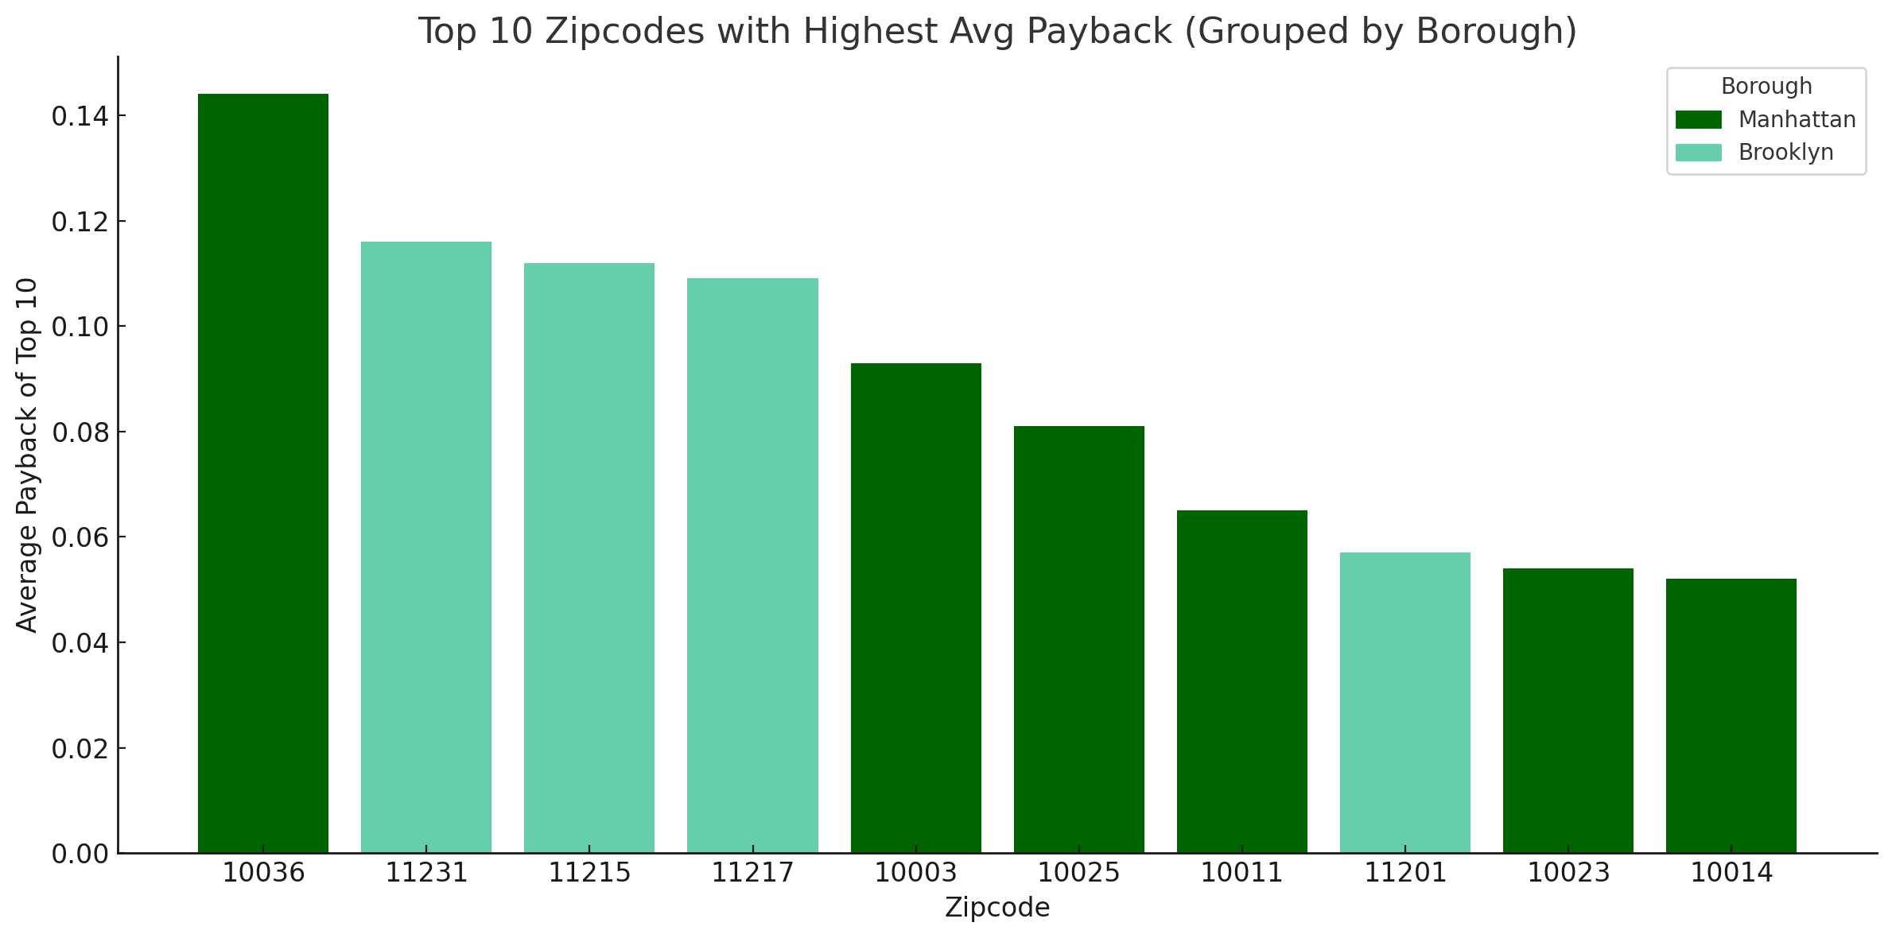

Slide 12
4:Summary

Slide 13
Reason to select NYC
1:High Increasing Rate
2:Stable Trend
Reason to select Kings
1:High growth
2:High volatility
3:Moderate Price
Final zipcodes to select
11231 11215 11217

